Slide 1
Segmenting C. ElegAns
Valerie Simonis
CSC 481: Final Project
11/18/2013

Slide 2
Outline
Motivation / Problem Statement
Related Work
Methodology
Data
Approach
Results
Demo Matlab GUI
Evaluation
Demo Matlab GUI
References

Slide 3
Motivation
Worm Video
Segmented Worm
Worm Tracking
Feature Collection
Results of segmentation used in two applications:
Track worms during video collection
Centroid approximations to move X-Y stage
Collect features to describe worm’s behavior
Morphology: area, length
Posture: curled, coiled, sinusoidal, …
Movement: crawling, turning, …
What sequence of image processing techniques should I apply to adequately segment C. elegans from its environment ?

Slide 4
Related Work
Segmentation is a common problem to any worm tracking or worm analysis application
In general, the algorithm used is dependent on the set of images on which analysis is to be done, resulting in different groups creating algorithms based on image acquisition:
“Histogram” approach (Yemini et al, 2012)
Using reference background value and apply window at all pixel locations to filter it out (Baek et al, 2002)
Using thresholding and morphological closing is standard approach
Hard to tell from literature how adequate algorithms are as it is not usually a focal point of papers

Slide 5
Methodology
Data and Approach

Slide 6
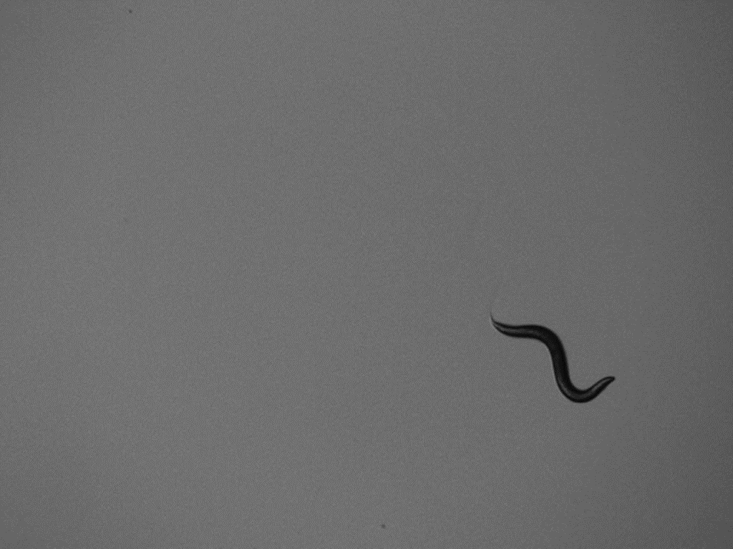
DAta
Dr. Hongkyun Kim at Roslind Franklin University
Resolution: 1024 x 768
Number of frames: 300
Number of independent sequences (between stage movements):19
Select 5 representative images from the set to test segmentation

Slide 7
Image Processing Sequence
Original Image
Image Enhancement
Thresholding
Morphological Operations
Segmented
Image
Histogram equalization
Contrast Stretching
Mean pixel value
Otsu
Histogram
Area Under Histogram
Opening
Closing
Connected Components

Slide 8
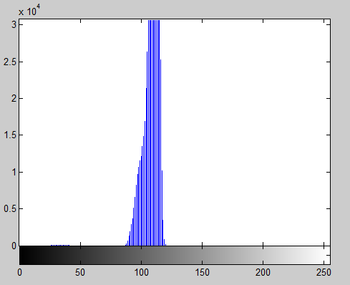
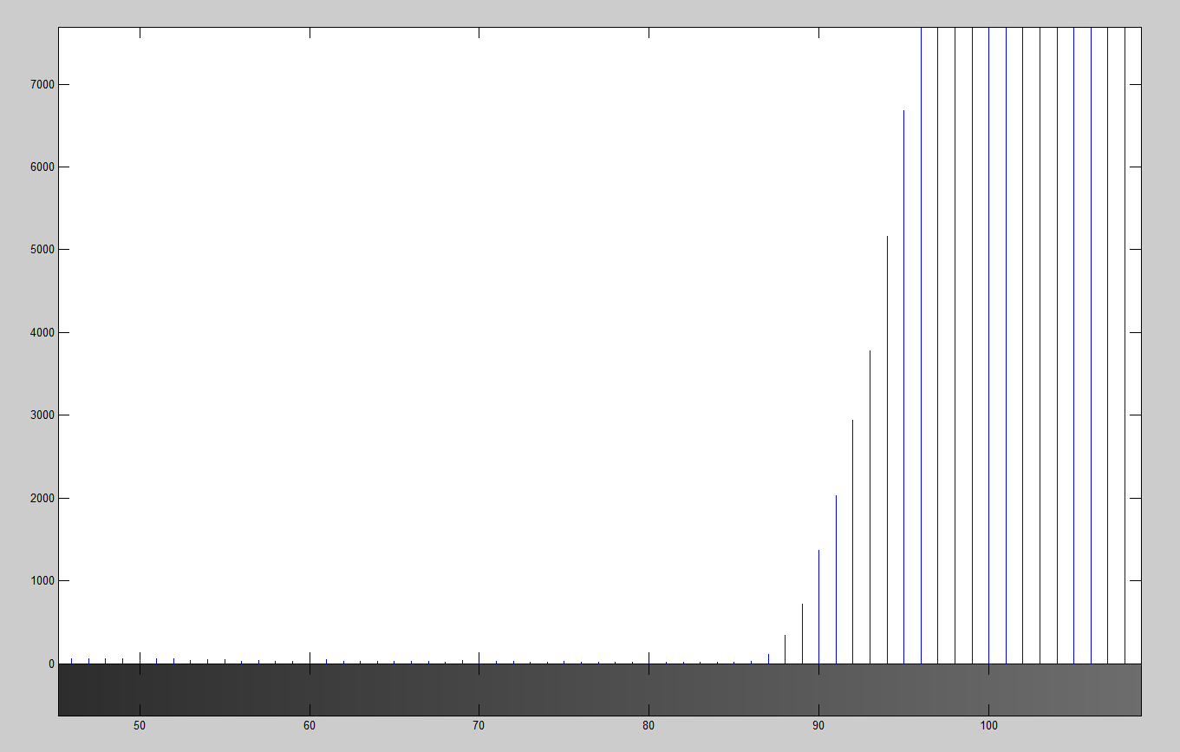
Threshold Descriptions
“Histogram”
“Area Under Histogram”
Find max = I(x,y) such that histogram is maximal
Find T = I(x,y) such that T is the nearest minimum to the left of max
Find T = I(x,y) such that the number of pixels in area to the left of T approximates the average area of a worm (4223)
max
worm
background
worm
background
# of pixels
==
avg area of worm
Nearest min to the left
T = 86
T = 78

Slide 9
Results
Demonstration

Slide 10
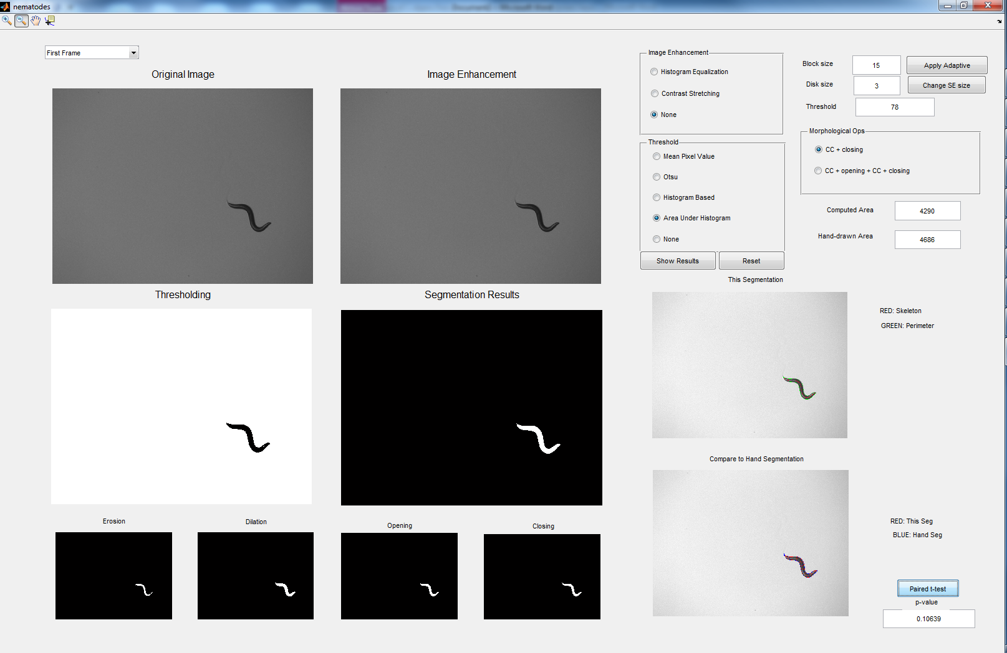
‘nematodes’ GUI: Algorithm builder/Tester
Notes:
medix-5.cstcis.cti.depaul.edu

Slide 11
Demo: medix-5.cstcis.depaul.edu
Data
Show each image & explain issue
Thresholds
“First Frame”
Mean Pixel Value
Otsu
Histogram
Area under histogram
“Intersect Artifact”
Contrast Enhancement
Area under histogram
Morphology medium

Slide 12
Evaluation

Slide 13
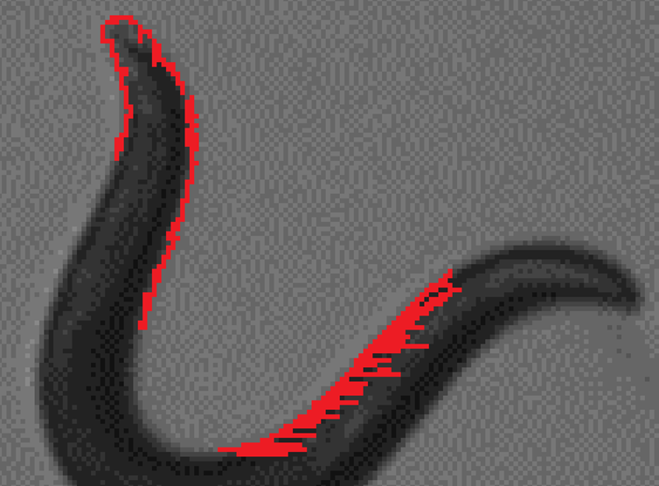
Hand segmentation
Zoom in to maximum possible and overlay pixels on image
Difficult!

Slide 14
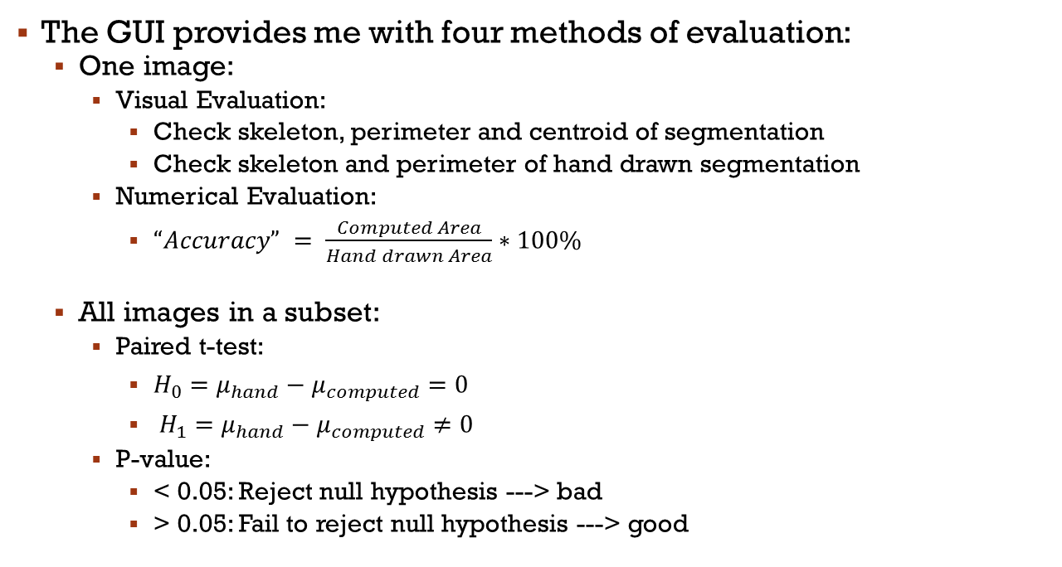
Evaluation Methods
The GUI provides me with four methods of evaluation:
One image:
Visual Evaluation:
Check skeleton, perimeter and centroid of segmentation
Check skeleton and perimeter of hand drawn segmentation
Numerical Evaluation:
$“Accuracy” = \frac{Computed Area}{Hand drawn Area}∗100\%$
All images in a subset:
Paired t-test:
$H_{0}=μ_{hand}−μ_{computed}=0$
$H_{1}=μ_{hand}−μ_{computed}≠0$
P-value:
< 0.05: Reject null hypothesis ---> bad
> 0.05: Fail to reject null hypothesis ---> good

Slide 15
Conclusions
Best Configuration: Area Under Histogram with morphological closing
First Frame: 91.5%
Curled: 96.1 %
Coiled: 97.1 %
Artifact: 86.9 %
Intersect Artifact: 101.7 %
P-value: 0.1
Visual check pretty good
Many improvements possible based on GUI results:
Select connected component approximately “worm-sized”
Split artifacts and remove them

Slide 16
References
Baek, J-H, Cosman, P. , Feng, Z., Silver J., William R. Schafer, W.R. (2002). Using machine vision to analyze and classify Caenorhabditis elegans behavioral phenotypes quantitatively. Journal of Neuroscience Methods. 118:9-21.
Cohen, E., Yemini, E, Schafer, W., Feiterlson D.G., Treinin, M. (2012). Locomotion analysis identifies roles of mechanosensory neurons in governing locomotion dynamics of C. elegans. Journal of Experimental Biology. 215:3639-48.
Wu, Q., Merchant, F.A., Castleman, K.R. (2008). Microscope Image Processing. Academic Press.
Gonzalez, R.C., Woods, R.E. (2008). Digital Image Processing, Third Edition.Pearson Prentice Hall.
MathWorks, (2012). Examples: Program GUI Components (R2013b). Retrieved November 18, 2013 from http://www.mathworks.com/help/matlab/creating_guis/examples-programming-gui-components.html

